Slide 1


CONTENT
STORY
MISSION
RULES
CONTROLS
ENEMIES
OBSTACLES
EXTRAS
IN GAME SCENE
COPYRIGHTS

Slide 2
story
IT‘S THE YEAR 3141*10^42 AND THE EARTH IS FACING A GALACTIC WAR WITH MANY RACES WHO
ARE TRYING TO CONQUER ALL RESOUCES WITHIN
THE MILKY WAY.
YOU HAVE BEEN SENT ON A COLLISION COURSE TO SUPPORT THE GALACTIC DEFENSE FORCES AND TO STOP AS MANY ENEMIES AS YOU CAN BEFORE THEY REACH THE SOLAR SYSTEM.
IF YOU FAIL TO STOP THE ENEMIES THE GALACTIC DEFENCE NETWORK WILL COLLAPSE AND THE EARTH CAN‘T STAND THE ALIENS FIRE AND WILL BE EXPLOITED AND DESTROYED...
MAY THE FORCE BE WITH <SORRY COPYRIGHTED>!

Slide 3
mission
EACH SHIP - LIKE YOURS – MUST CONTRIBUTE TO THE GALACTIC FORCES TO DEFEND THE EARTH.
SO YOUR MISSION IS TO DO A CERTAIN AMOUNT OF WORK FOR A GIVEN TIME SPAN.
YOU MUST REACH A CERTAIN SCORE FOR A GIVEN TIME SPAN TO CONFIRM THAT YOU ARE MERIT TO BE PART OF THE GALATIC FORCES.
YOU HAVE UP TO 6 LIVES. WHEN YOU DIE WITH YOUR LAST LIFE THE GALACTIC DEFENSE NETWORK WILL COLLAPSE AND THE EARTH WILL BE CONQUERED!
ALL INFORMATION ARE DISPLAYED WITHIN YOUR HUD.

Slide 4
rules
YOU MUST DESTROY THE ENEMIES AND ACHIEVE A GIVEN SCORE BEFORE THE TIMER IS UP.
THE ENEMIES ARE RADIOACTIVE GALACTIC APES AND UFOS FROM ALPHA CENTAURI.
YOU CAN HAVE UP TO 6 LIVES.
IF YOU DIE WITH 1 LIVE YOU‘RE GAME OVER.
YOU CAN EARN 1 LIVE BY CATCHING 100 ENERGY RINGS WHICH THE EARTH‘S SERVICE FORCES SPREAD IN SPACE.
WHEN YOUR MISSION STARTS THEN YOU ONLY HAVE IMPULSE DRIVE AND YOU ARE SLOW.
YOU CAN FLY UP TO WARP 2 BY CATCHING UP TO 2 WARP CORES WHICH THE EARTH‘S SERVICE FORCES SPREAD IN SPACE.
IF YOU COLLIDE WITH AN ENEMY EACH TIME YOUR WARP CORE WILL OVERHEAT AND YOU WILL SLOW DOWN AGAIN.
PREVENT COLLISIONS WITH ANY OBSTRACLES EXCEPT OF RINGS, HEARTS AND WARP CORES.
ANY OTHER COLLISION WILL REDUCE YOUR HEALTH.
YOU CAN REGENERATE YOUR HEALTH BY CATCHING HEARTS.

Slide 5
CONTROLS
TITLE SCREEN CONTROLS ARE MARKED WITH BRACES
LIKE „(1) START LEVEL 1“:
MEANS PRESSING THE KEY „1“ STARTS THE 1ST LEVEL.
IN GAME CONTROLS
(W) UP
(A) LEFT
(D) RIGHT
(S) DOWN
(SPACE) SHOOT
(P) PAUSES/RESUMES THE GAME AND RETURNS TO THE TITLE SCREEN/IN GAME SCENE
(PRINT-KEY) SCREENSHOT SAVED IN LAUNCHED FOLDER
(F1) TOGGLE BLOOM FILTER
(F2) TOGGLE SHADOW FILTER (ONLY USE BY APES)
(F3) TOGGLE LIGHT SCATTERING FILTER
(USED FOR SHIP EXPLOSION)

Slide 6
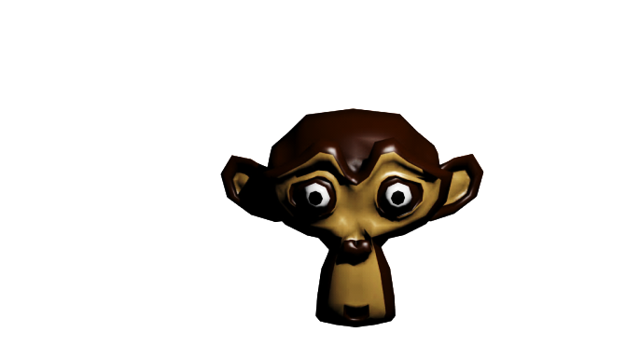
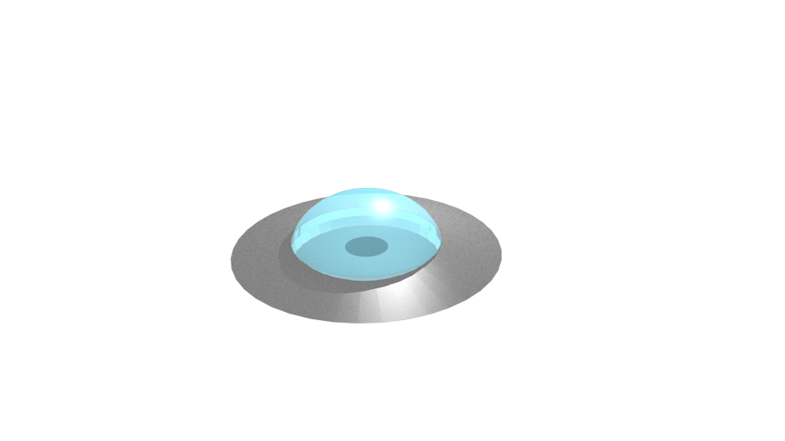
enemies
THESE RADIOACTIVE SPACE APES FROM
TAU CETI MOVE RANDOMLY IN CIRCLES.
SO BE PREPARED FOR ANY UNEXPECTED
MOVEMENTS.
UFOS FROM ALPHA CENTAURI MOVE
FAST AND IN GROUPS AND MAKE MORE
DAMAGE THAN THE APES.
SO TRY TO AVOID ANY COLLISIONS.

Slide 7
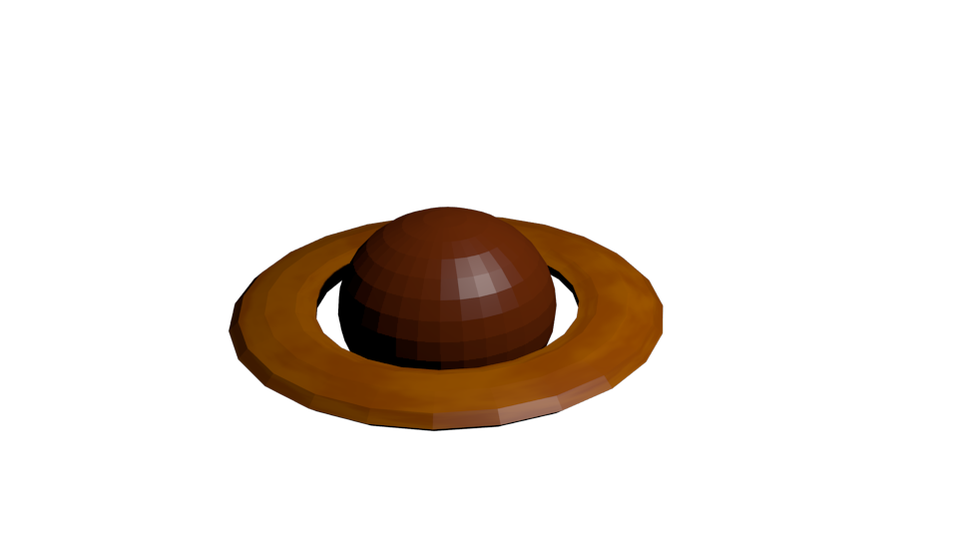
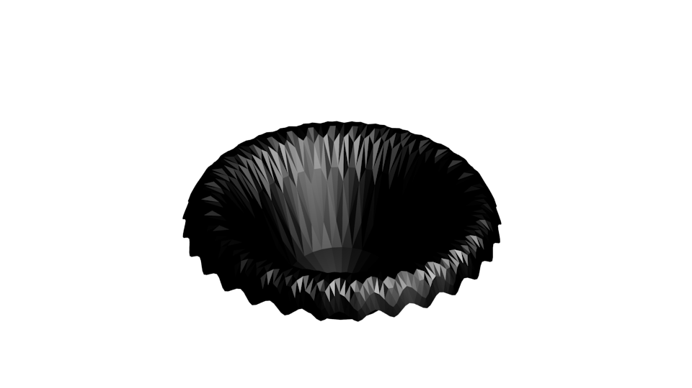
obstacles
AVOID COLLISIONS WITH RANDOM
PLANETS WHICH YOU MEET IN SPACE.
THEIR COLLISION‘S WILL MAKE A
LOT OF DAMAGE.
STAY FAR AWAY FROM BLACK HOLES
THEY WILL ATTRACT YOU AND AND
TAKE YOUR HEALTH WHEN YOU COME
CLOSE TO THEM:

Slide 8



extras
THESE RINGS LOAD YOUR ENEGY UP TO 100
IF YOU CAUGHT 100 OF THEM THEN YOUR
LIVE WILL INCREASE BY +1
DURING THE GAME YOU CAN TAKE DAMAGE
FROM ENEMIES AND OBSTACLES. THESE
HEARTS WILL RE-GENERATE A BIT OF HEALTH.
YOU NEED TO CATCH WARP CORES TO ENABLE
YOUR TWO WARP DRIVES TO FLY FASTER.
YOUR WARP DRIVES OVERHEAT FROM COLLISIONS.

Slide 9
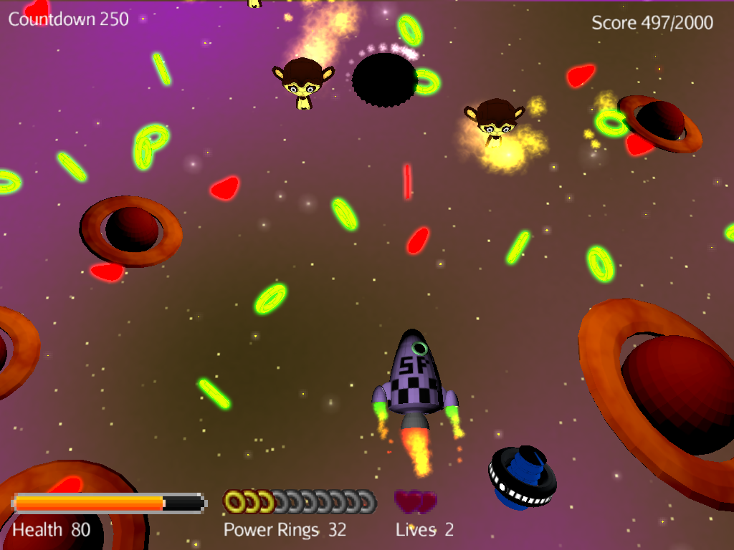
IN GAME SCENE

Slide 10
GAME COUNTDOWN
YOU MUST REACH THE „MUST SCORE“ BEFORE THE TIME‘S UP
CURRENT SCORE/TARGET SCORE
ENEMY
STAY AWAY FROM BLACK HOLES!
DON‘T COLLIDE WITH PLANETS! MAKE LOT OF DAMAGE BUT ALSO GIVE MANY POINTS!
GIVES YOU HEALTH
100 POWER RINGS = 1 LIVE
THAT IS YOU!
YOURHEALTH
CAUGHT POWER RINGS
YOUR LIVES
WARP CORE SPEEDS YOU UP

Slide 11
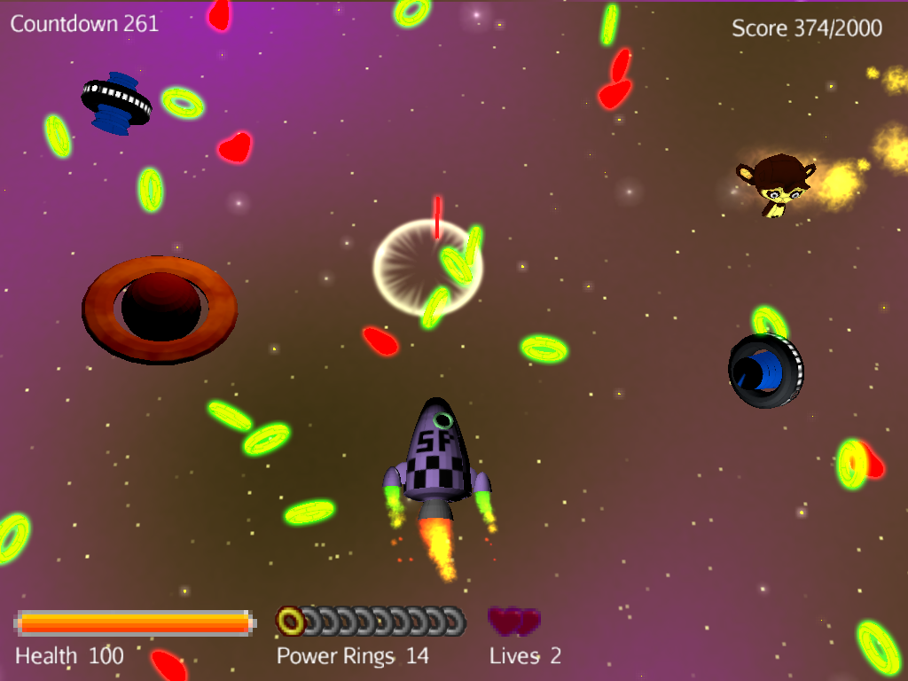
FOR EVERY WARP CORE YOU PICK UP YOU WARP DRIVES AN THE SIDE WILL BE ACTIVATED AND SPEED YOU UP!

Slide 12
copyrights
GAME BY SAMAN SEDIGHI RAD, VISIT: HTTP://SSRAD.ORG/SPACEBIT FOR ANY FUTURE DEVELOPMENT
ROCKET DESIGN AND SPACE.BIT LOGO EXCLUSIVELY PROVIDED BY ALEXANDER ANSARI
MUSIC RELEASED BY 8BITPEOPLES UNDER CREATIVE COMMONS: HTTP://8BITPEOPLES.COM
APE MODEL: BUILD IN BLENDER. MODEL UNDER BSD LICENSE. HTTP://BLENDER.ORG
ALL OTHER MODELS CREATED AND COPYRIGHT BY
SAMAN SEDIGHI RAD
GAME ENGINE PROVIDED BY JMONKEYENGINE (V3), UNDER BSD LICENSE: HTTP://JMONKEYENGINE.ORG
SOUNDS CREATE WITH FAMITRACKER. EXPLOSION SOUND
WITH COMMUNITY HELP: HTTP://FAMITRACKER.COM/FORUM/POSTS.PHP?ID=244
SKYBOXES CREATED WITH SPACESCAPE
HTTP://ALEXCPETERSON.COM/SPACESCAPE

